Slide 1
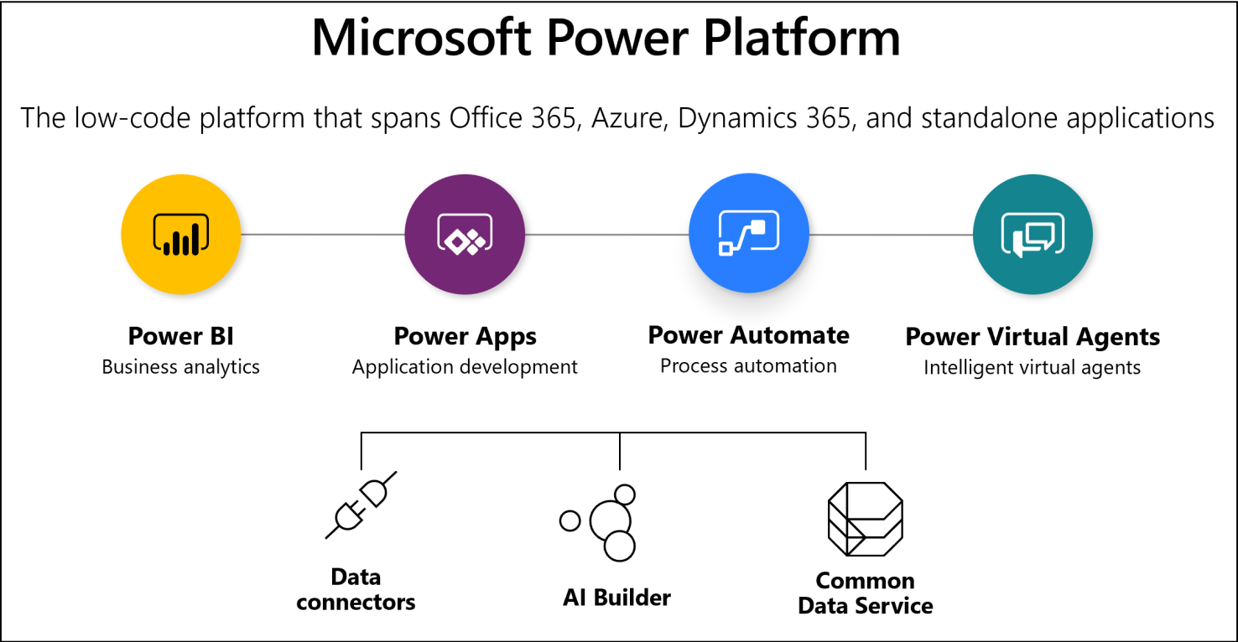
MICROSOFT POWER PLATFORM
Jane Pham
https://www.youtube.com/channel/UCikyZD7q006IVZ2t5dB8opQ
https://janebraine.tech/
https://github.com/tramchip/training_documents

Slide 2
The Purpose
What is this session about
Introduce people to the platform and Microsoft’ related certificates for this platform as most people might not aware that it comes with Office 365 subscriptions
Helping people have an adequate Power Platform’s vocabularies to start using the services
Encourage you to check out the Power Platform’s ability
What it is not ?
No test prep

Slide 3
Agenda
Introduction of the Power Platform
Related Certificates and Prospective
Introduction of the Power Apps
Introduction of the Power Automate
Power Automate use cases
Introduction of the Power BI
Introduction of the Power Virtual Agent

Slide 4
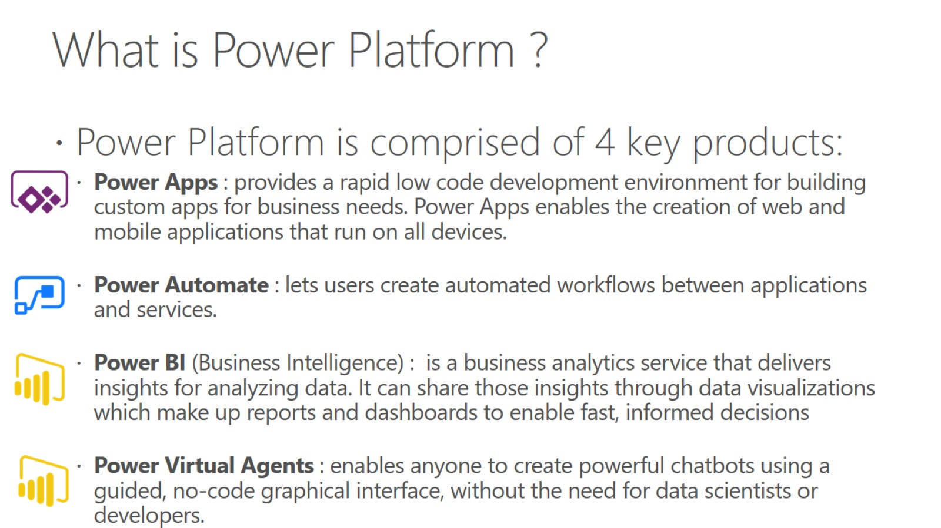
What is Power Platform ?

Slide 5
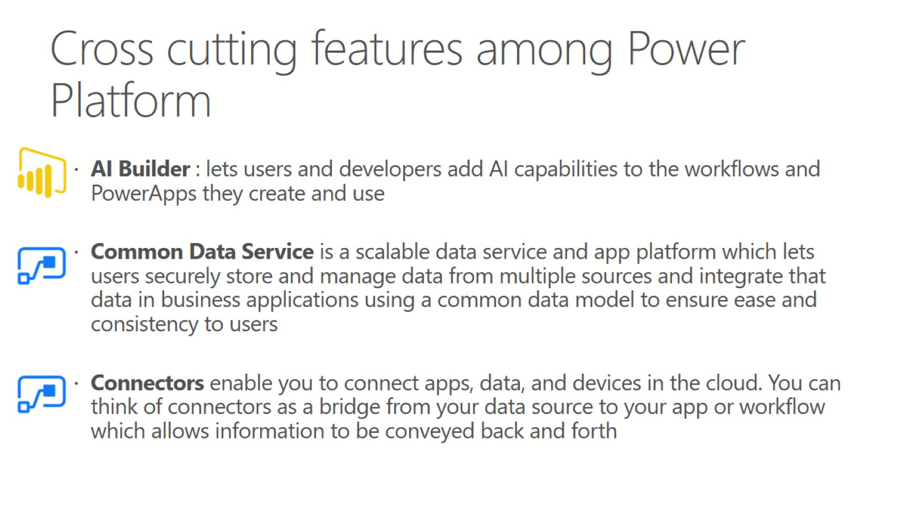
Cross cutting features among Power Platform

Slide 6
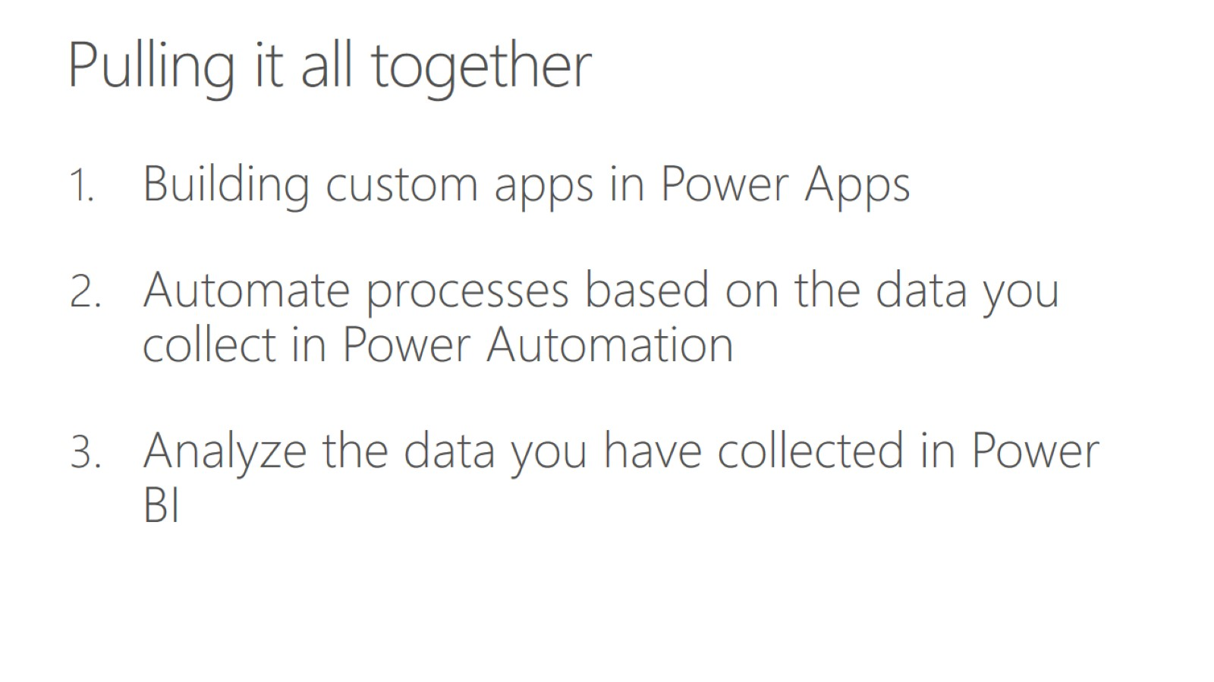
Pulling it all together

Slide 7
RELATED CERTIFICATES FOR THE POWER PLATFORM

Slide 8
Certification history
Power Platform originally was lumped up with the Dynamic 365 in MB -200 exam (retiring on Dec 2020)
New exams for Power platform: here
PL-900
PL-100 (beta mode, discount available)
Power Platform Functional Consultant Associate (Sept 2020)
Power Platform Developer Associate (Sept 2020)
New Azure data related exams that test on a component of Power Platform (mainly Power BI): DA-100, DP-900

Slide 9
Future of the Power Platform
Microsoft product suite is widely used in the big Corporate environment
Low code / No code solution that has an ability to integrate with AI features
Essential tools for Business Analyst, PM , Helpdesk , or anyone who has a daily communication and data process with Microsoft Suite – The Microsoft Office future
Microsoft is promoting Power Platform
New certificates
Forum where people come and discuss here
#PowerAddicts hashtag to share and learn on Twitter here
Tips : check for pay rate on Upwork to see the demand

Slide 10
MICROSOFT POWER APPS

Slide 11
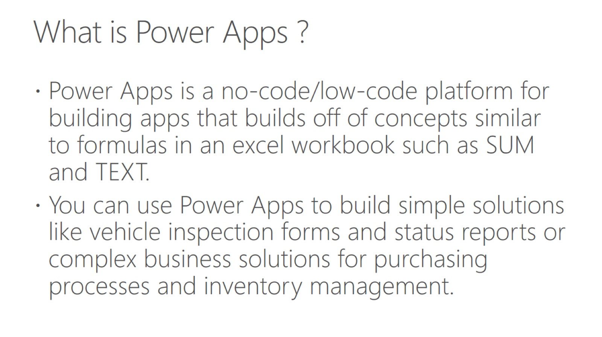
What is Power Apps ?

Slide 12
The Purpose
What is this session about
Introduce people to the platform and Microsoft’ related certificates for this platform as most people might not aware that it comes with Office 365 subscriptions
Helping people have an adequate Power Platform’s vocabularies to start using the services
What it is not ?
No test prep

Slide 13
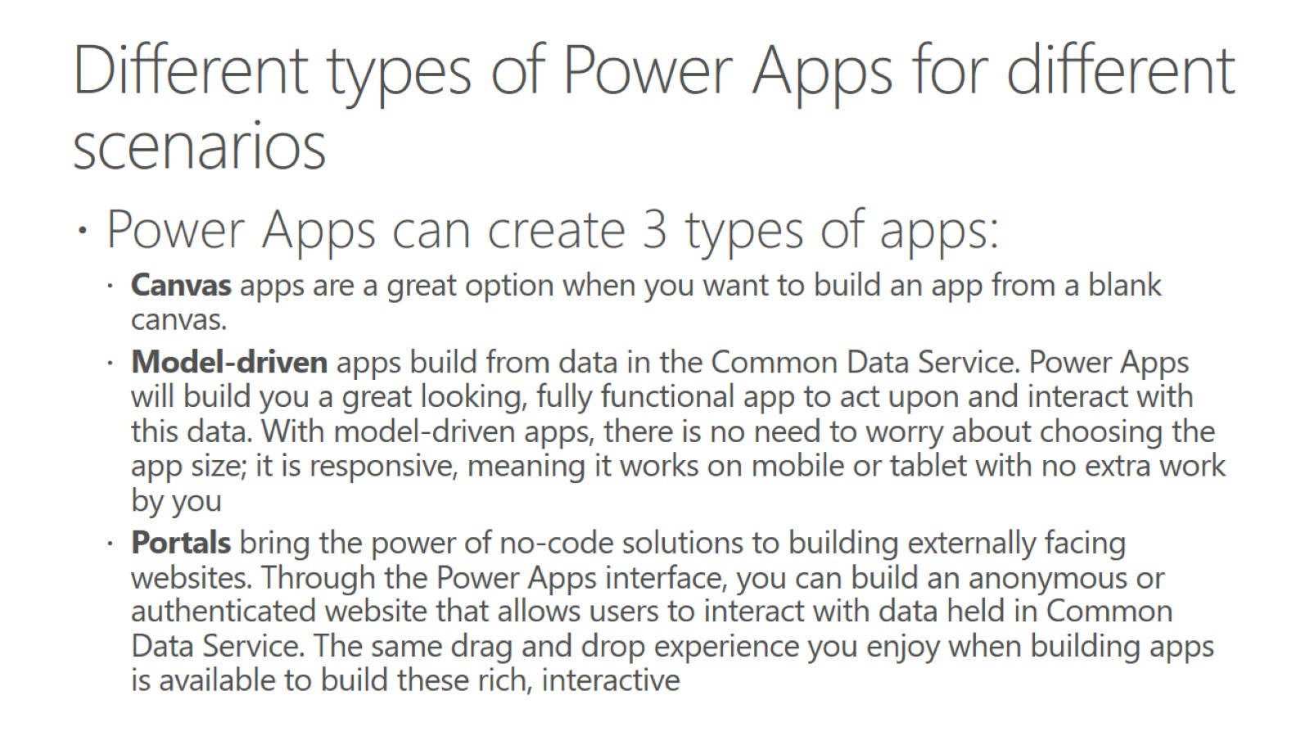

Slide 14
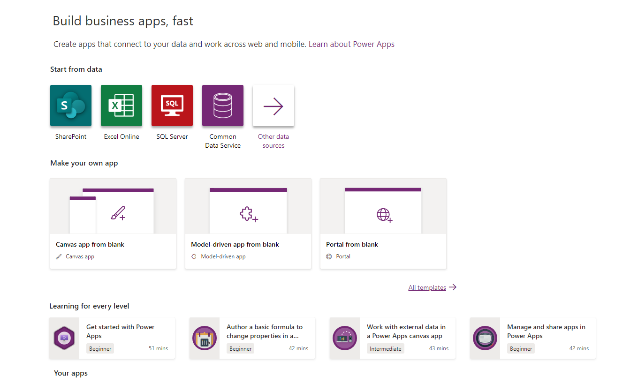

Slide 15
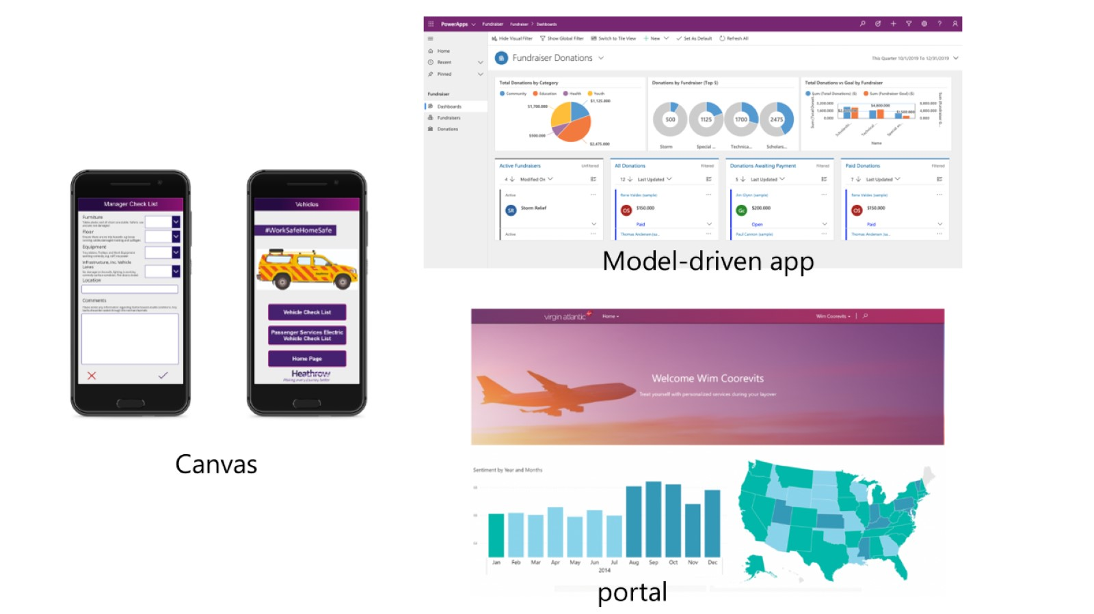

Slide 16
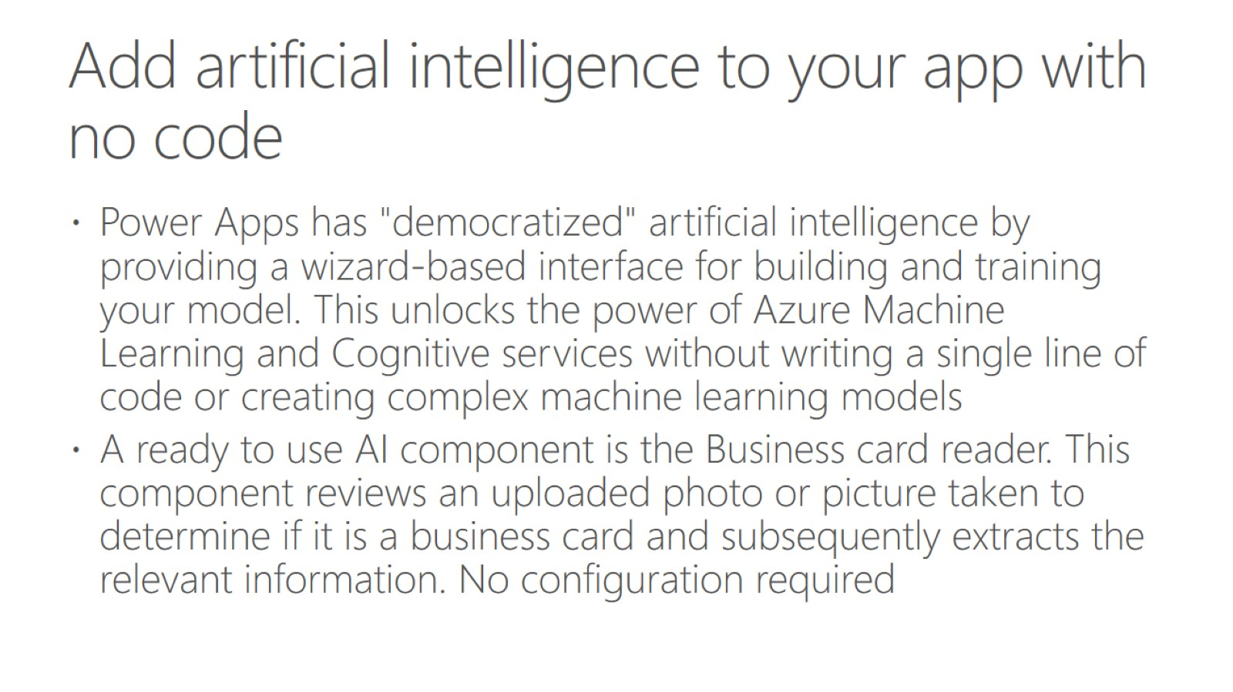
Add artificial intelligence to your app with no code

Slide 17
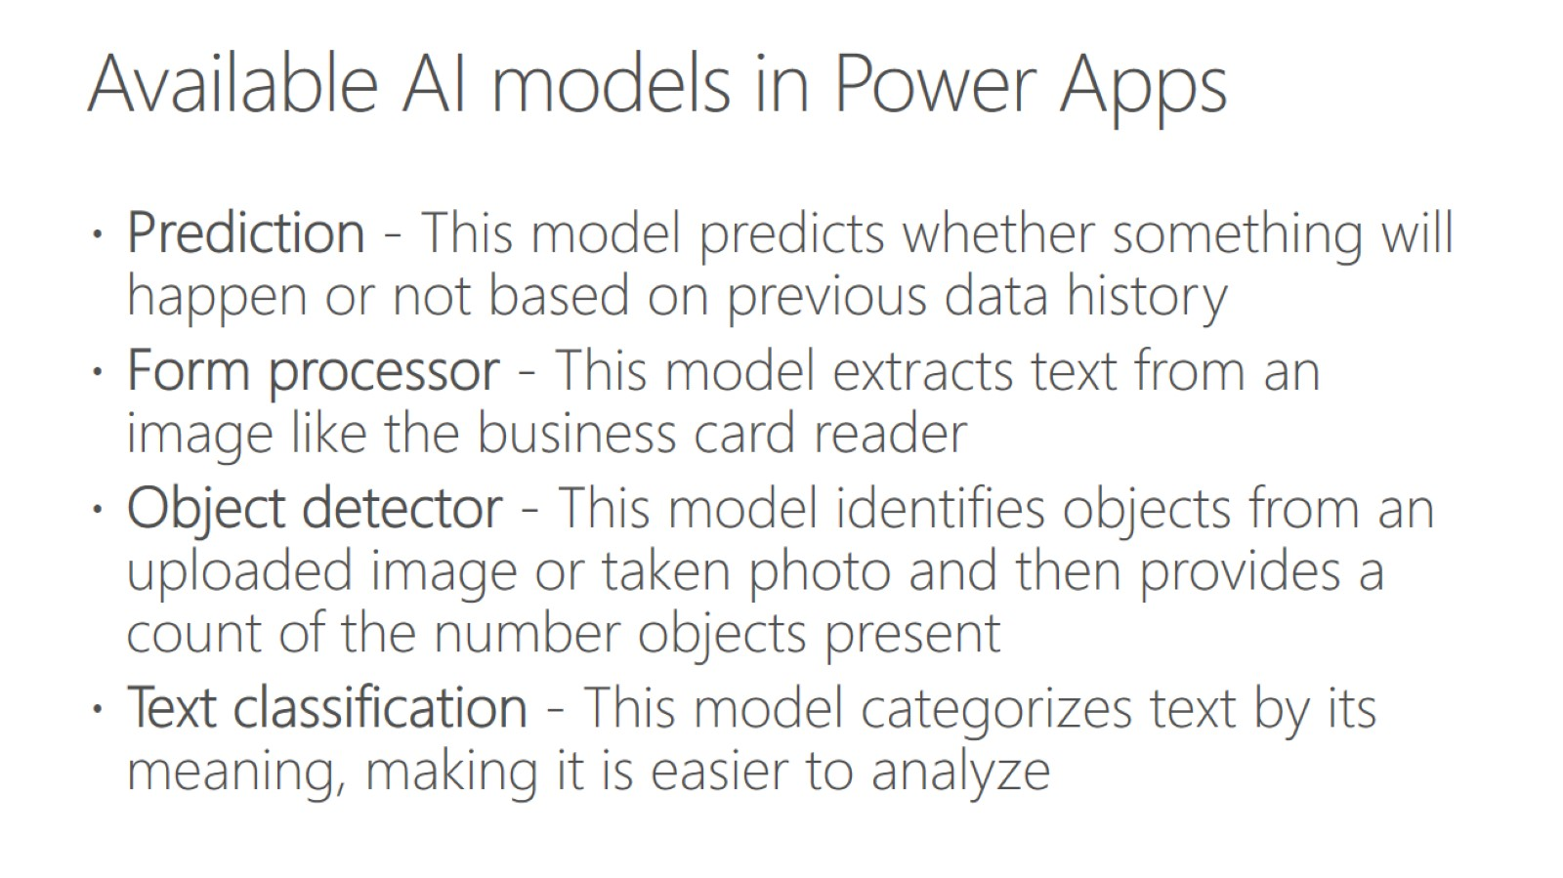
Available AI models in Power Apps

Slide 18
MICROSOFT POWER AUTOMATE

Slide 19
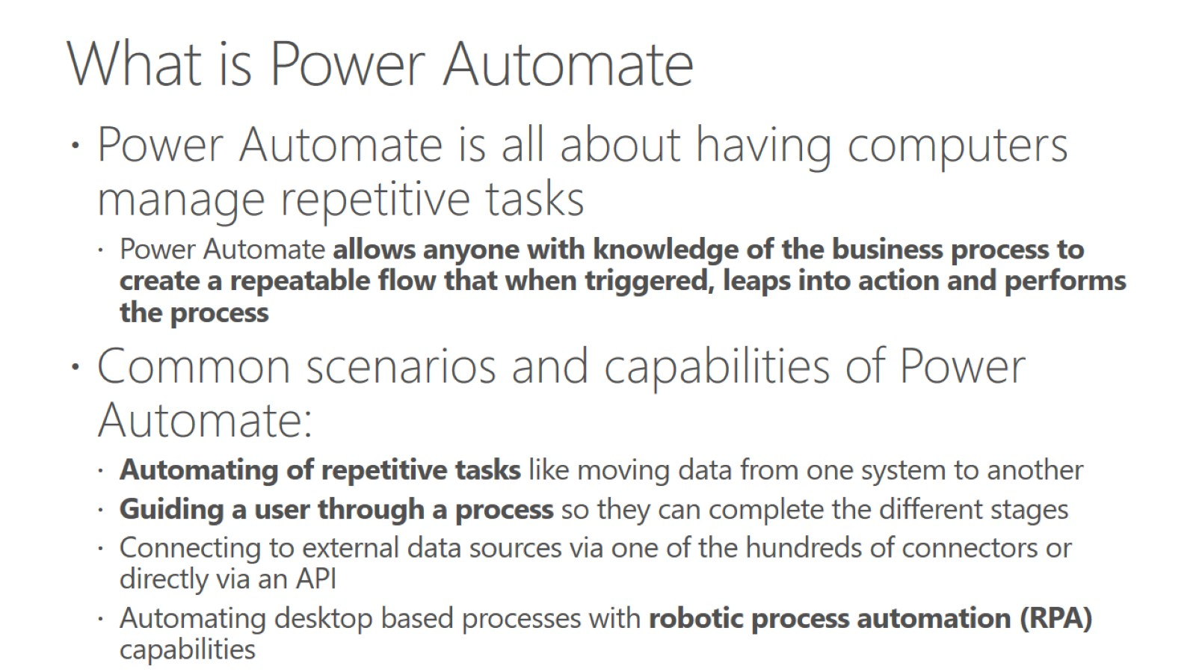

Slide 20
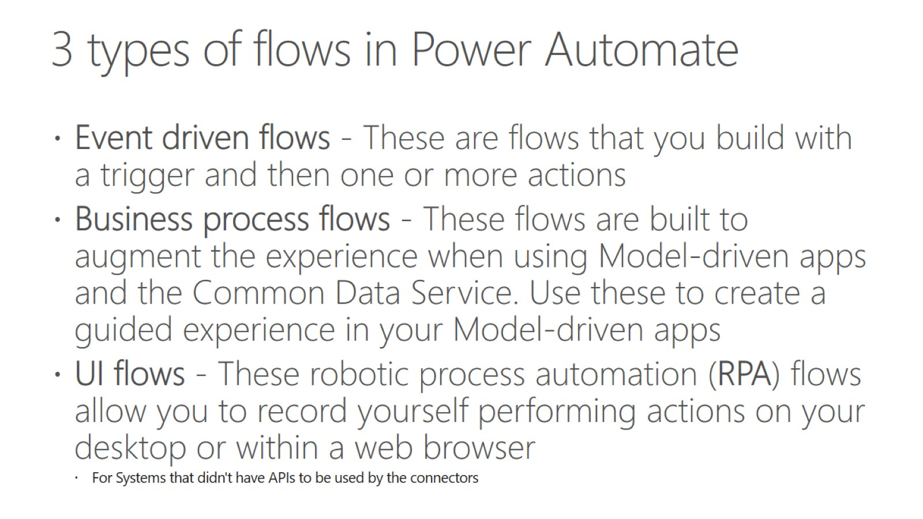

Slide 21
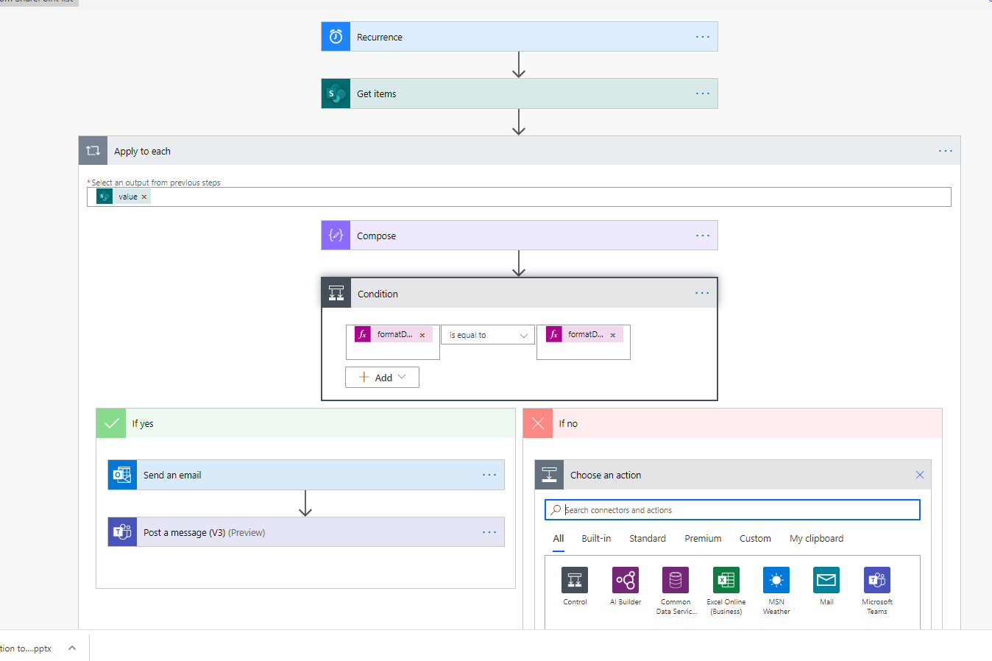

Slide 22
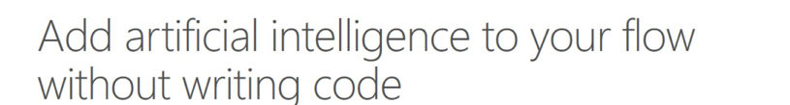
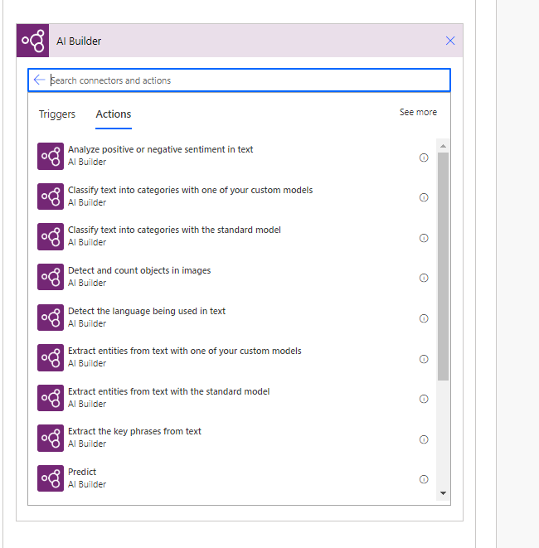

Slide 23
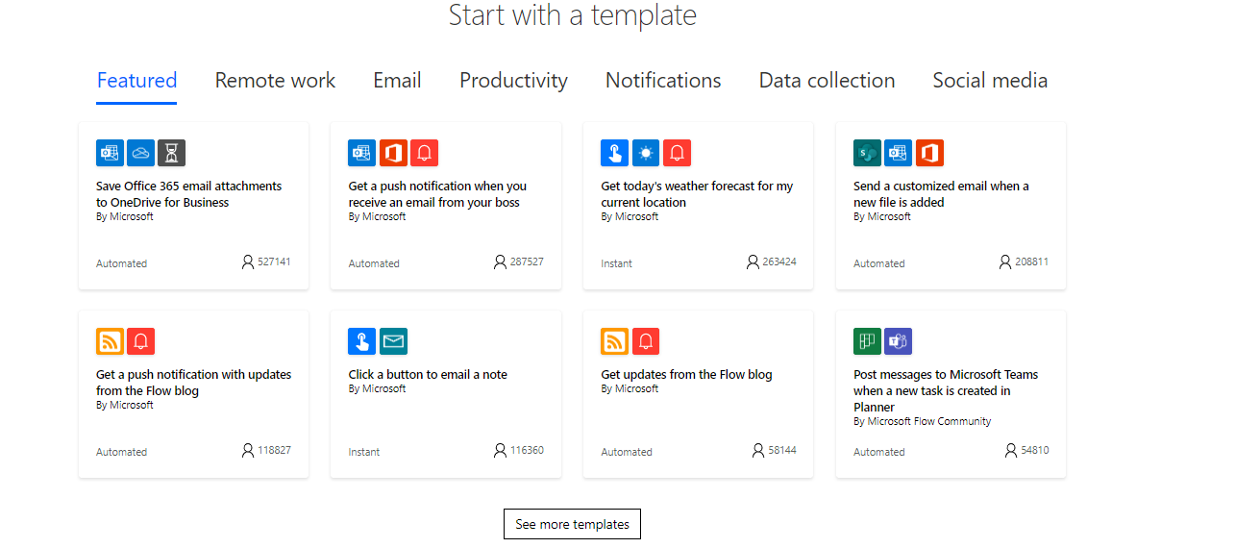

Slide 24
MICROSOFT POWER AUTOMATE USECASE

Slide 25
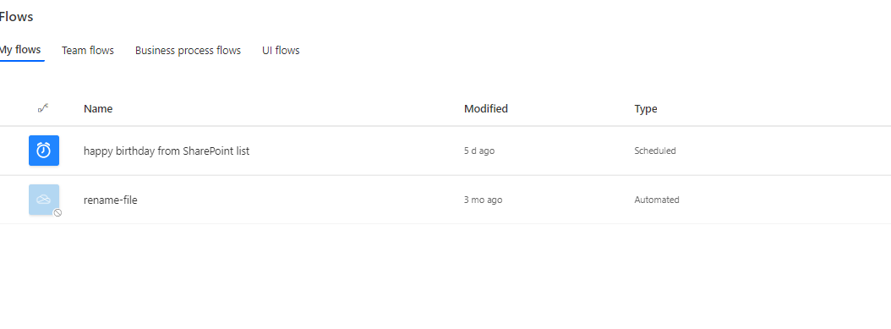

Slide 26
MICROSOFT POWER BI

Slide 27
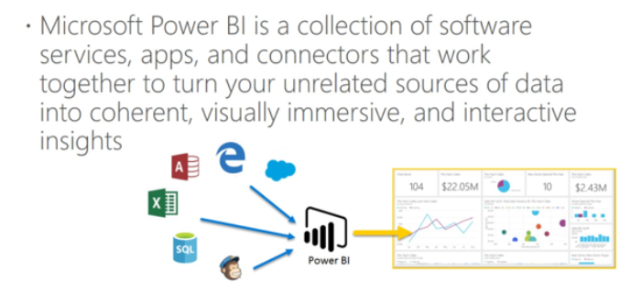
Introduction of Power BI
Comes with 3 licenses :Power BI Free, Power BI Pro. Power BI Premium
Business Analytics solution that led you to visualize data and share it across organization

Slide 28
MICROSOFT POWER VIRTUAL AGENT

Slide 29
Introduction of Power Virtual Agent
Use to create bots without Data Scientist expertise
Drag – drop like features
Integrated AI abilities for natural conversation
Notes:
Quiz , what is NLP service in Azure

Slide 30
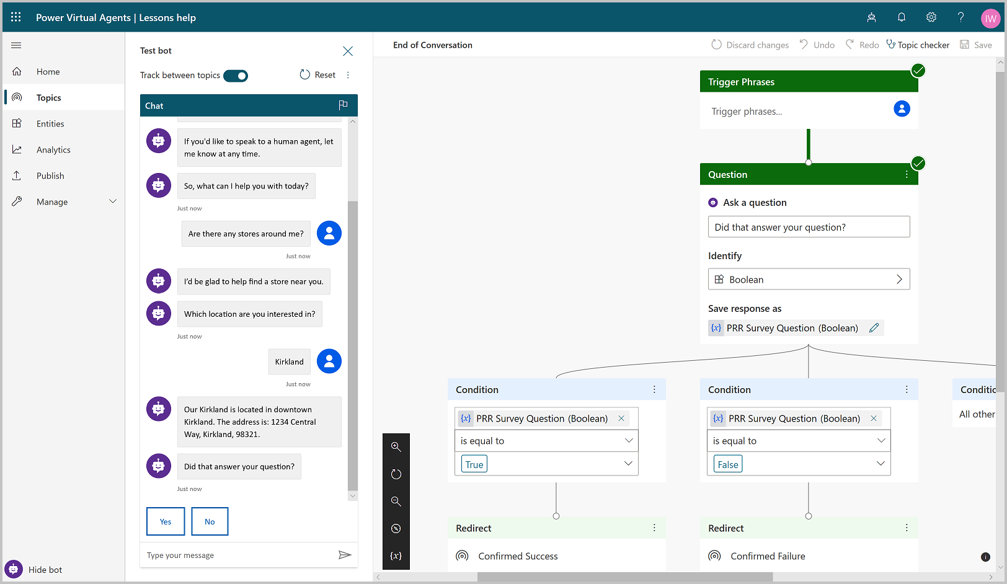

Slide 31
Resources
https://docs.microsoft.com/en-us/power-platform/
https://stanislas.io/2020/04/03/preparation-guide-for-pl-900-microsoft-power-platform-fundamentals-certification/

